Slide 1
Loan Analytics Banking Data Presentation Using MS Excel, MySQL, Power BI & Tableau By Group 4

Slide 2
Summary:
We performed an analysis on Banking data for Loan having 65,000+ records and drawn KPI from it using excel, my SQL and also used visualization tools like tableau and also used power bi to make dynamic dashboard.
This dashboard provides an in-depth view of the bank's lending performance, portfolio distribution, and borrower demographics. It highlights key financial KPIs such as total loans, funded amounts, repayments, interest rates, and risk metrics. The dashboard also visualizes loan distribution by product, age group, region, branch, and religion, enabling data-driven decisions on loan strategies, risk management, and customer targeting.

Slide 3
Key Performance Indicators (KPIs)
KPI | Value | Insight
Total Loans | 65.5K | Total number of loans disbursed across branches.
Total Loan Funded | ₹73.27 Cr | Total principal amount lent to customers.
Total Collection | ₹81.49 Cr | Total repayments collected.
Total Interest Rate | 12.03% | Average rate of interest on loans.
Delinquent Loan Rate | 10.8% | Portion of overdue loans.
Default Loan Rate | 1.6% | Share of loans defaulted permanently.
Delinquent Loan Count | 7,106 | Number of delinquent clients.
Default Loan Count | 1,020 | Number of clients in default.

Slide 4
Loan Status Breakdown
Active Loans: 11,532
Fully Paid: 15,809
NPA: 135
Home Loan Share: ₹164 Cr
26–35 Age Group: ₹198 Cr loans

Slide 5
Branch-Wise Revenue Performance
✅ Top Performing Branches:
Mathura – ₹26.67 Cr (Highest revenue generator)
Fatehgarh Sahib – ₹25.16 Cr
Haridwar – ₹24.71 Cr
🔻 Lowest Performing Branches:
Agra – ₹18.40 Cr (Lowest revenue among the listed branches)
Khordha – ₹18.22 Cr
Behroh – ₹19.47 Cr

Slide 6
Product Group-Wise Loan Distribution
✅ Top Performing Loan Products:
Home Loan – ₹278.26 Cr (Dominant product with almost double the next category)
Services – ₹155.53 Cr
Business – ₹82.54 Cr
🔻 Lowest Performing Loan Products:
Festive Loan-Product – ₹10.95 Cr (Lowest funded product)
Mobile Phones – ₹11.90 Cr
Emergency Loan – ₹25.83 Cr
.

Slide 7
Religion-Wise Loan Distribution
Hindu: 75% of total loans
Followed by Sikh (13%), Muslim (11%), and others.
Insight: Hindu and 26–35 age group are the dominant borrower segments.
Age Group-Wise Loan
Age 26–35 has the highest loan amount: ₹261 Cr
Followed by 36–45 and 46–55 groups

Slide 8
State-Wise Loan Distribution
Rajasthan: ₹138.46 Cr (Highest)
Madhya Pradesh: ₹3.00 Cr
Odisha: ₹8.47 Cr
Loan Grade Distribution
Majority of loans are in Grades A, B, and C, comprising ~64%

Slide 9
Disbursement Trend
Highest disbursement was in FY 2019 (56.97%)
No disbursement in the latest FY
Loan Maturity Patterns
Loans vary between 36 to 60 months, with a majority in the short-term bracket.
Need for product structuring based on customer repayment capacity.

Slide 10
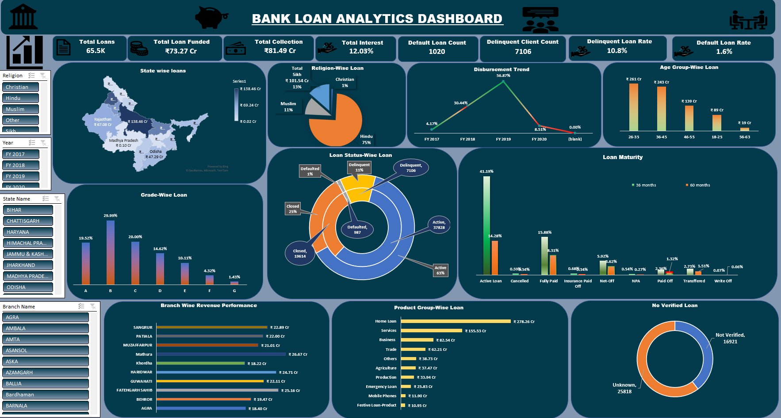
Excel Dashboard

Slide 11
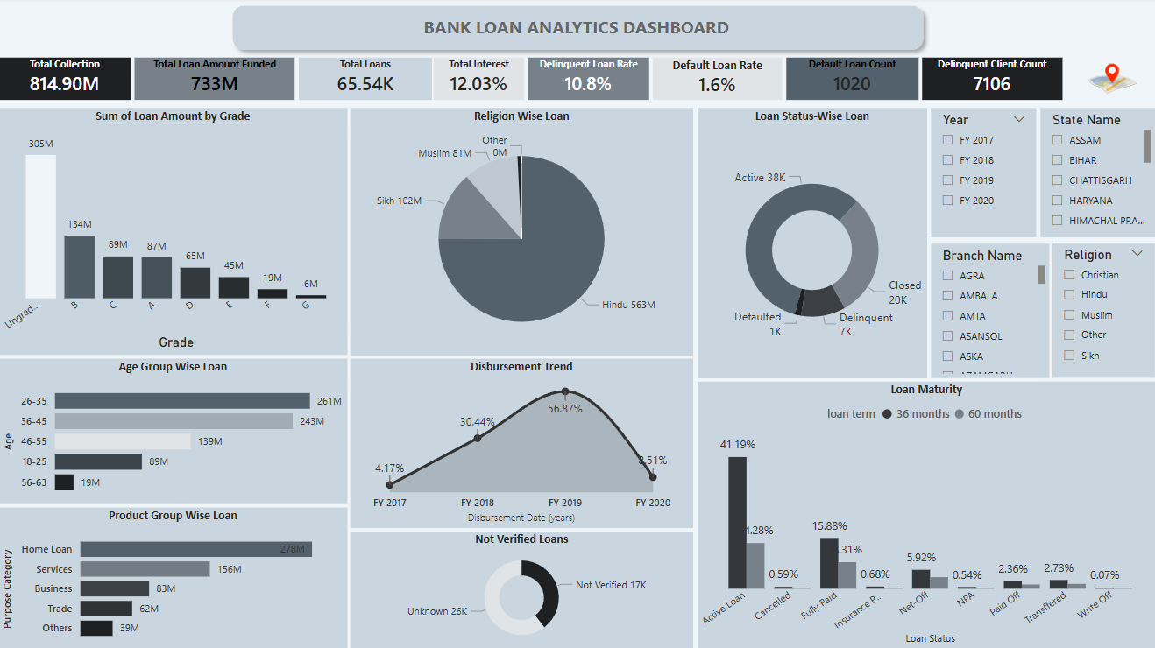
Power BI Dashboard

Slide 12
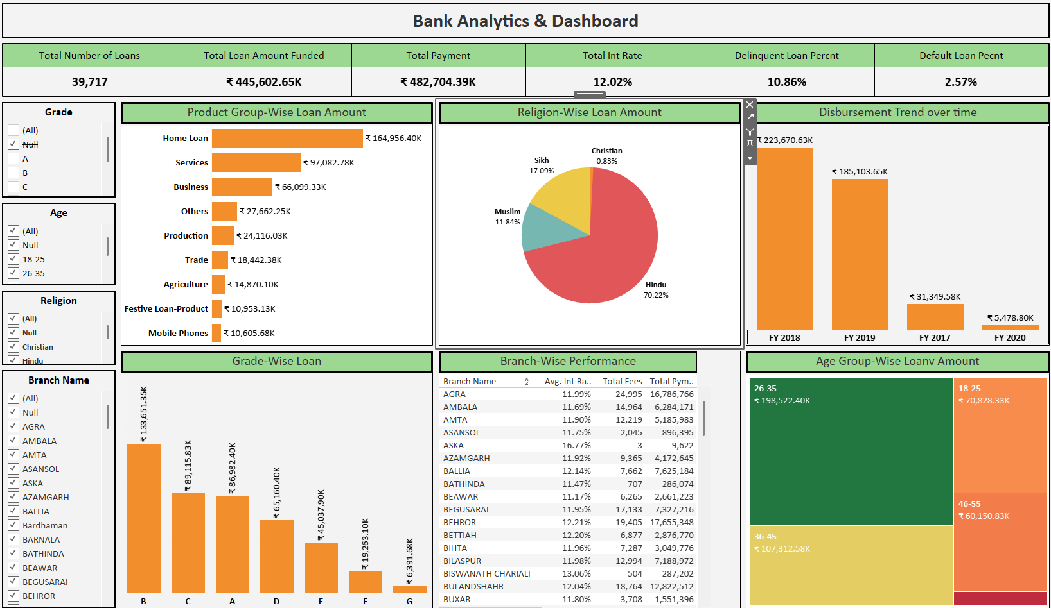
Tableau Dashboard

Slide 13
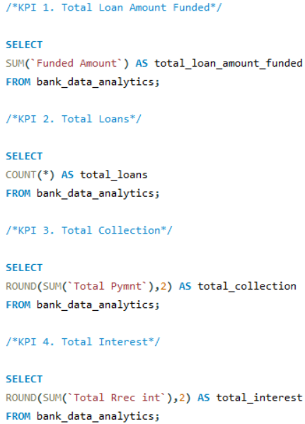
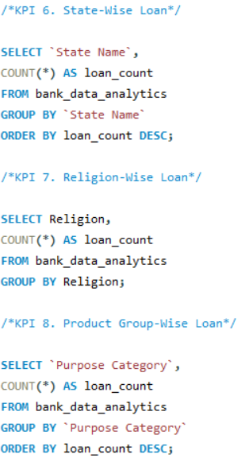
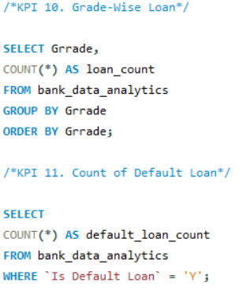
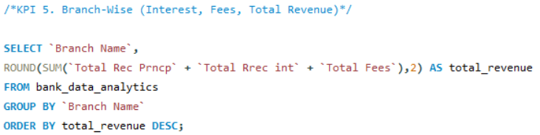
SQL Queries

Slide 14
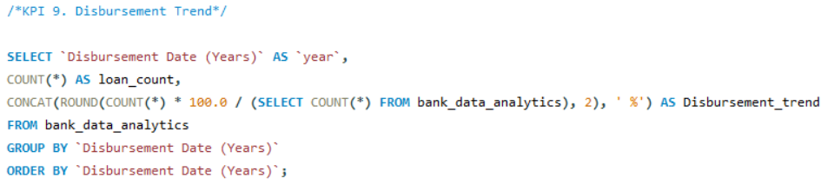
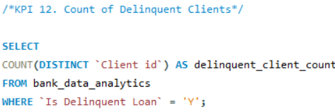
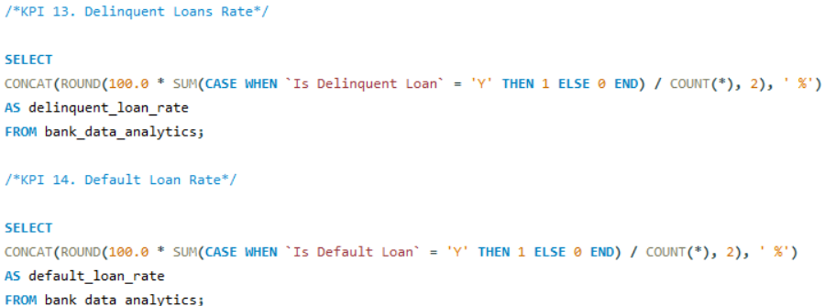
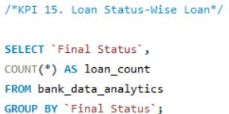
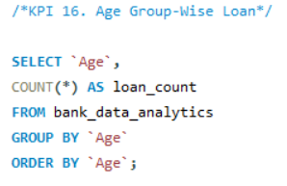
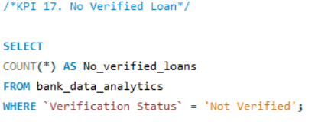
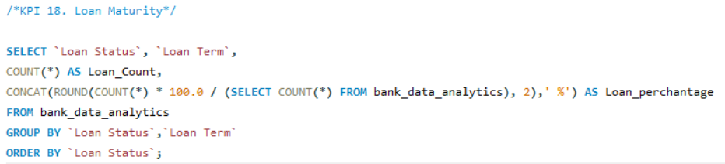
SQL Queries

Slide 15
Key Takeaways & Insights
Healthy Loan Book: Majority of loans are fully paid or active; NPA and default rates are within manageable limits.
Home Loans Lead: Dominant product at ₹164 Cr+; indicates focus on secured lending.
Verification Gaps: 32% loans not verified; improvement needed for risk management.
Regional Focus: UP, Rajasthan, and Odisha are top performing states.
Demographic Skew: Young adults (26–35) are the highest borrowers—great for long-term engagement.
Branch Variation: AGRA, AMBALA, and ASANSOL have highest payments and fees.
Disbursement Decline: FY 2018 saw highest disbursement; sharp drop in FY 2020 may suggest COVID impact.

Slide 16
Thank You

